Slide 2
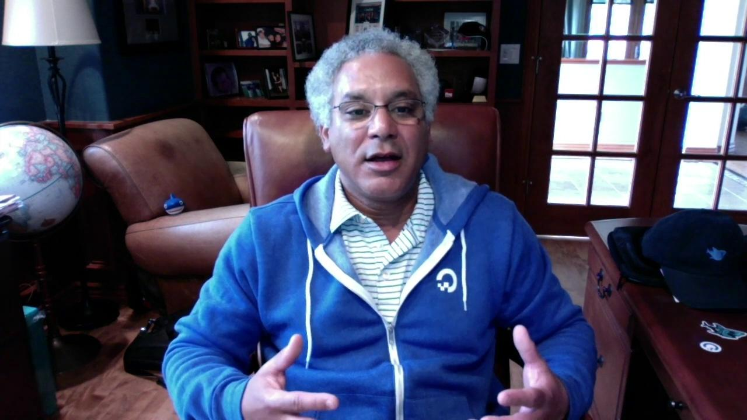

Slide 4











Presented by

